Slide 1
Iannis Zervas MD How clean is he?
Over the past 20 years:
Advisory boards (one for each): Astra Zeneca, Bristol, Lundbeck
Lectures in industry sponsored scientific symposia
(not product talks): Eli-Lilly, Astra- Zeneca
Research and education grants: Pfizer, Lundbeck, Verisfield
(all of the above according to Greek FDA regulations and through university contracts
All funds acquired were used to support the women’s mental health clinic function)

Slide 2
Women’s Mental Health in Athens: the first ten years ( 2003-2013)
Iannis Zervas MD
Associate Professor of Psychiatry
Athens University School of Medicine
Chief, Women’s Mental Health and Perinatal Psychiatry Clinic
Eginition University Hospital, Athens, Greece

Slide 3
Women’s Mental Health Clinic in Athens U
Founded officially June 2003 - first in Greece
In line with WHO principles for Special Programs for Gender Equality
Psychopharmacology
Multiple orientations psychotherapy services
Consultation services
Supervision services
Network with OB-GYN clinics and genetics services
Team training (weekly intramural seminars)
Training students, residents, postgraduates, psychiatrists
Community education
Research based on dissertation projects
No major sources of funding

Slide 4
Personnel and associates: The art and chaos of coordinating part-timers !
Staff and collaborating Psychiatrists
Visiting trainees (special programs)
Residents
Dissertation candidates
Psychologists
Social workers
Midwifes
OB-GYN
Endocrinologists

Slide 5
Evaluations, consultations and clinical follow up of women with psychological and psychiatric problems in relation to:
The perinatal period (pregnancy, puerperium, mother-baby bonding)
Fertility issues (infertility and IVF) and reproductive issues in women with psychiatric illness under medication treatment
Perimenopause and Menopause
Interpersonal issues and parenting role

Slide 6
Also psychological and psychiatric problems in relation to :
The menstrual cycle
Gynaecological problems and illness
Emotional disorders co-morbid with endocrine problems in women
Depression and anxiety in women related to psychosocial stressors

Slide 7
Consultation, liaison and mentoring services for consultants
C/L for maternity wards
Assistance and consultation for gynaecologists, pediatricians and endocrinologists treating patients with psychiatric problems
Advising and / or mentoring psychiatrists and psychologists treating patients with reproductive issues

Slide 8
Functions
Daily function
Referral
Telephone Screening
Evaluation appointment
Treatment planning meeting
Psychotherapies
C/L with maternity units
Collaboration with treating physicians
Research
Educational activities

Slide 9
Center population (2004-2011)
Clinical follow-up: Ν = 684 women
Research programs: N= 428 subjects

Slide 10
Research programs
Anxiety during pregnancy
Postpartum depression
Insomnia and Depression in Menopause
Psychological stress in women with remitting-relapsing MS
Neuropsychology in depression in women
Cognitive schemas and bonding in chronic depression

Slide 11
WMHC Publications
35 publications in international peer-reviewed journals
10 book chapters for Greek psychiatry books and textbooks
Translations of 3 books (on mental health in menopause/ D. Stewart, mother-infant attachment / J. Holmes, and the mindset of motherhood /D.Stern, )

Slide 12
Epidemiology / Psychometrics
Tzavara C Tzonou A, Zervas I, Ravens-Sieberer U, Dimitrakaki C, Tountas Y. Reliability and validity of the KIDSCREEN-52 health-related quality of life questionnaire in a Greek adolescent population. Ann Gen Psychiatry. 2012 13;11:3.
Giannouli P, Zervas I, Armeni E, Koundi K, Spyropoulou A, Alexandrou A, Kazani A, Areti A, Creatsa M, Lambrinoudaki I. Determinants of quality of life in Greek middle-age women: a population survey. Maturitas. 2012 Feb;71(2):154-61.
Leonardou AA, Zervas YM,, Papageorgiou C C, Marks MN, Tsartsara EC, Antsaklis A, Christodoulou GN, Soldatos CR. (2009) Validation of the Edinburgh Postnatal Depression Scale and prevalence of postnatal depression at two months postpartum in a sample of Greek mothers. 27 (1): pp. 28-39
Zervas I, Pehlivanidis A, Botsari O, Dimitrakopoulos C, Markidis M, Christodoulou G. "Hysteria" near the end of the twentieth century in Athens. Psychiatrike. 2007 Oct;18(4):351-60.

Slide 13
Menopause
Spyropoulou AC, Zervas IM, Christodoulakos G, Lambrinoudaki I, Rizos D, Koundi K, Sanida E, Creatsas G, Soldatos CR. Irritability in menopause: an investigation of its relation to menopausal, hormonal and physical factors. Psychother Psychosom. 2009;78(2):128-30.
Zervas IM, Lambrinoudaki I, Spyropoulou AC, Koundi KL, Voussoura E, Tzavara C, Verdeli H, Aravantinos L, Creatsa M, Paparrigopoulos T. Additive effect of depressed mood and vasomotor symptoms on postmenopausal insomnia. Menopause. 2009 Jul-Aug;16(4):837-42. doi: 10.1097/gme.0b013e318196063e.
Spyropoulou A, Zervas I, Lambrinoudaki I, Rizos D, Koundi K, Tzavara Ch, Sanida E, Augoulea A, Vousoura E, Christodoulakos G, Creatsas G, Soldatos CR. A study of irritability in menopausal women. Psychiatrike. 2008 Apr;19(2):115-23.
Koundi KL, Christodoulakos GE, Lambrinoudaki IV, Zervas IM, Spyropoulou A, Fexi P, Sakkas PN, Soldatos CR, Creatsas GC. Quality of life and psychological symptoms in Greek postmenopausal women: association with hormone therapy. Gynecol Endocrinol. 2006 Dec;22(12):660-8.

Slide 14
Perinatal
Arvaniti A, Spyropoulou A, Zervas I. Parenting capacity of mothers with schizophrenia Psychiatrike. 2012 Oct-Dec;23(4):314-21.
Spyropoulou AC, Tsartsara EI, Angelopoulou A, Zervas IM. Psychiatric manifestations preceding fetal death in antiphospholipid syndrome.Gen Hosp Psychiatry. 2010 Mar-Apr;32(2):225-7.
Lambrinoudaki I, Rizos D, Armeni E, Pliatsika P, Leonardou A, Sygelou A, Argeitis J, Spentzou G, Hasiakos D, Zervas I, Papadias C. Thyroid function and postpartum mood disturbances in Greek women. J Affect Disord. 2010 Mar;121(3):278-82.
Chatzicharalampous C, Rizos D, Pliatsika P, Leonardou A, Hasiakos D, Zervas I, Alexandrou A, Creatsa M, Konidaris S, Lambrinoudaki I. Reproductive hormones and postpartum mood disturbances in Greek women. Gynecol Endocrinol. 2011 Aug;27(8):543-50.
Boufidou F, Lambrinoudaki I, Argeitis J, Zervas IM, Pliatsika P, Leonardou AA, Petropoulos G, Hasiakos D, Papadias K, Nikolaou C. CSF and plasma cytokines at delivery and postpartum mood disturbances. J Affect Disord. 2009 May;115(1-2):287-92. doi: 10.1016/j.jad.2008.07.008. Epub 2008 Aug 15.
Spyropoulou AC, Zervas IM, Soldatos CR. Hip dysplasia following a case of olanzapine exposed pregnancy: a questionable association. Arch Womens Ment Health. 2006 Jul;9(4):219-22.

Slide 15
Stress in Women
Mitsonis C, Voussoura E, Dimopoulos N, Psarra V, Kararizou E, Latzouraki E, Zervas I, Katsanou MN. Factors associated with caregiver psychological distress in chronic schizophrenia. Soc Psychiatry Psychiatr Epidemiol. 2012 Feb;47(2):331-7.
Mitsonis CI, Zervas IM, Potagas CM, Mitropoulos PA, Dimopoulos NP, Sfagos CA, Papadimitriou GN, Vassilopoulos DC. Effects of escitalopram on stress-related relapses in women with multiple sclerosis: an open-label, randomized, controlled, one-year follow-up study. Eur Neuropsychopharmacol. 2010 Feb;20(2):123-31.
Mitsonis CI, Potagas C, Zervas I, Sfagos K. The effects of stressful life events on the course of multiple sclerosis: a review. Int J Neurosci. 2009;119(3):315-35. 16.
Mitsonis CI, Zervas IM, Mitropoulos PA, Dimopoulos NP, Soldatos CR, Potagas CM, Sfagos CA. The impact of stressful life events on risk of relapse in women with multiple sclerosis: a prospective study. Eur Psychiatry. 2008 Oct;23(7):497-504.
Pariante CM, Vassilopoulou K, Velakoulis D, Phillips L, Soulsby B, Wood SJ, Brewer W, Smith DJ, Dazzan P, Yung AR, Zervas IM, Christodoulou GN, Murray R, McGorry PD, Pantelis C. Pituitary volume in psychosis. Br J Psychiatry. 2004 Jul;185:5-10.

Slide 16
Depression in women
Michopoulos I, Zervas IM, Pantelis C, Tsaltas E, Papakosta VM, Boufidou F, Nikolaou C, Papageorgiou C, Soldatos CR, Lykouras L. Neuropsychological and hypothalamic-pituitary-axis function in female patients with melancholic and non-melancholic depression. Eur Arch Psychiatry Clin Neurosci. 2008 Jun;258(4):217-25.
Michopoulos I, Zervas IM, Papakosta VM, Tsaltas E, Papageorgiou C, Manessi T, Papakostas YG, Lykouras L, Soldatos CR. Set shifting deficits in melancholic vs. non-melancholic depression: preliminary findings. Eur Psychiatry. 2006 Sep;21(6):361-3. Epub 2006 Jul 11.
Alevizos B, Alevizos E, Leonardou A, Zervas I. Low dosage lithium augmentation in venlafaxine resistant depression: An open-label study. Psychiatrike. 2012 Apr-Jun;23(2):143-8. (Gr)
Michopoulos IM, Zervas IM. Psychotherapeutic approaches of depression. Psychiatrike. 2009 Jul;20(3):211-21 (Gr)

Slide 17
Consultation-Liaison
Markopoulos CJ, Spyropoulou AC, Zervas IM, Christodoulou GN, Papageorgiou C. Phantom breast syndrome: The effect of in situ breast carcinoma. Psychiatry Res. 2010 Oct 30;179(3):333-7.
Mitsonis C, Dimopoulos N, Zavrou M, Psarra V, Giofkos C, Fiorakis C, Dimitriadis A, Valavanis D, Vousoura E, Zervas I, Papavassiliou E. Panic Attack during Elective Gastrointestinal Endoscopy. Gastroenterol Res Pract. 2011;2011:162574. doi: 10.1155/2011/162574. Epub 2011 Oct 4.
Kontoangelos K, Vaidakis N, Zervas I, Thomadaki O, Christaki S, Stavrianeas NG, Papadimitriou GN. Administration of inositol to a patient with bipolar disorder and psoriasis: a case report. Cases J. 2010 Feb 23;3:69. doi: 10.1186/1757-1626-3-69.
Mourikis I, Zervas I. Disorders of sweating in psychiatry Psychiatrike. 2008 Jan;19(1):59-72.
Zervas IM, Soldatos CR. Nightmares: personality dimensions and psychopathological attributes. Int Rev Psychiatry. 2005 Aug;17(4):271-6. Review.

Slide 18
ECT
Kaliora SC, Braga RJ, Petrides G, Chatzimanolis J, Papadimitriou GN, Zervas IM. The Practice of Electroconvulsive Therapy in Greece. J ECT. 2013 Jan 4. [Epub ahead of print]
Zervas IM, Theleritis C, Soldatos CR Using ECT in schizophrenia: a review from a clinical perspective. World J Biol Psychiatry. 2012 Feb;13(2):96-105. Review.
Kokras N, Politis AM, Zervas IM, Pappa D, Markatou M, Katirtzoglou E, Papadimitriou GN. Cardiac rhythm: management devices and electroconvulsive therapy: a critical review apropos of a depressed patient with a pacemaker. J ECT. 2011 Sep;27(3):214-20.
Masdrakis VG, Oulis P, Zervas IM, Karakatsanis NA, Kouzoupis AV, Karapoulios E, Soldatos CR. The safety of the electroconvulsive therapy-aripiprazole combination: four case reports. J ECT. 2008 Sep;24(3):236-8.
Alevizos B, Zervas IM, Hatzimanolis J, Alevizos E. Attitudes of Greek nonpsychiatrist physicians toward electroconvulsive therapy. J ECT. 2005 Sep;21(3):194-5.
Papakosta VM, Zervas IM, Pehlivanidis A, Papadimitriou GN, Papakostas YG.
A survey of the attitudes of Greek medical students toward electroconvulsive therapy. J ECT. 2005 Sep;21(3):162-4

Slide 19
Educational Activities
Women’s Mental Health ( lectures and seminars for
medical students, psychiatric trainees, psychologists,
midwives, parent schools etc.)
Involvement in postgraduate training programs
C/L in OB/GYN
Research in Reproductive Mental Health
Interpersonal Psychotherapy
Schema therapy

Slide 20
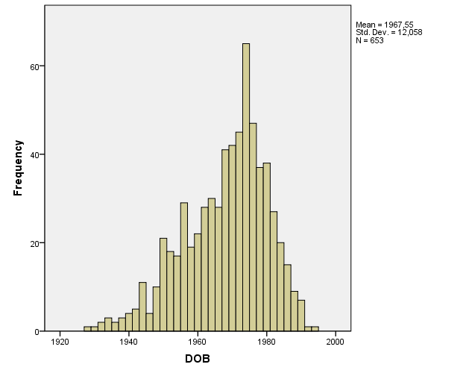
Clinical Population
Ν = 653 (end of 2010)
Mean age: 44 years (range: 19-83)

Slide 21
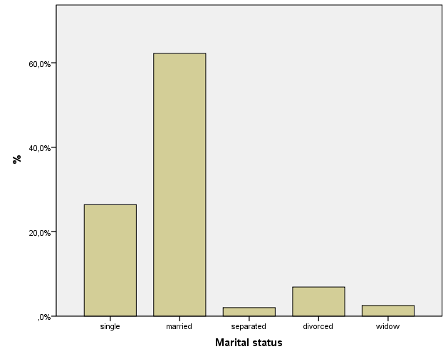
Demographics

Slide 22
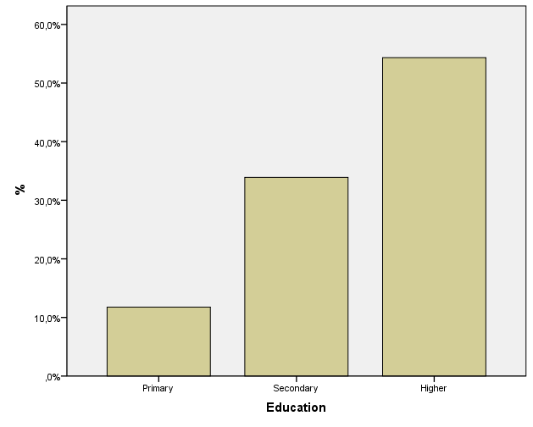
Education

Slide 23
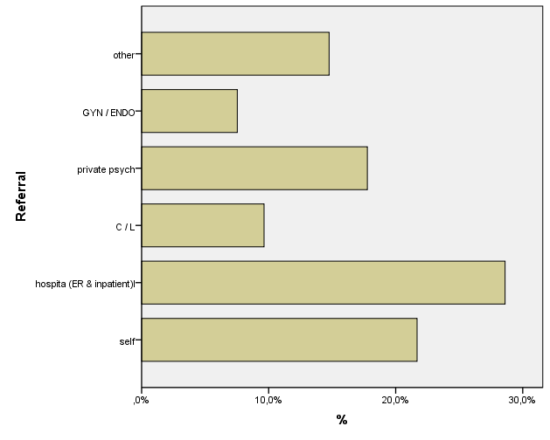
Referrals

Slide 24
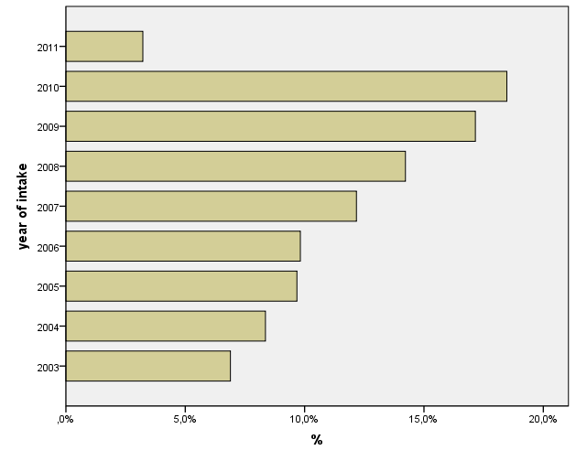
New caseload

Slide 25
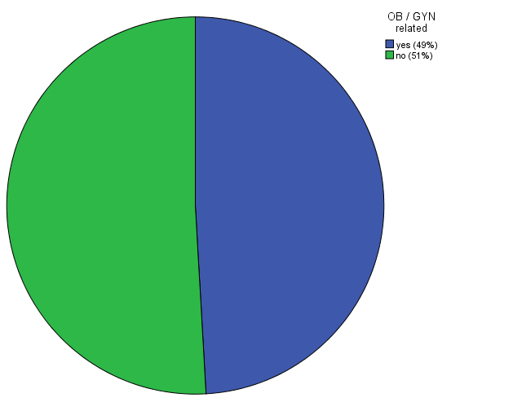
OB/GYN vs non-OB/GYN cases

Slide 26
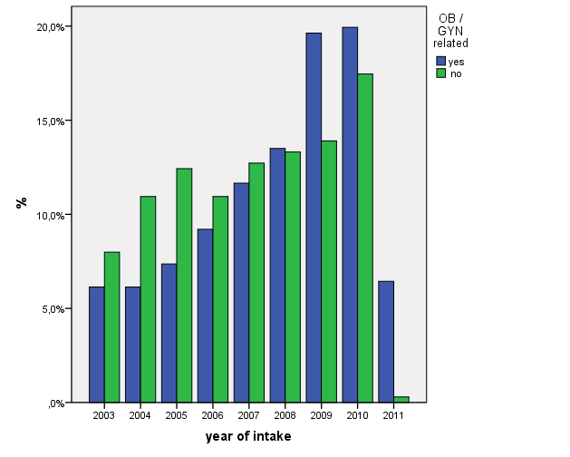
OB/GYN cases increase by year

Slide 27
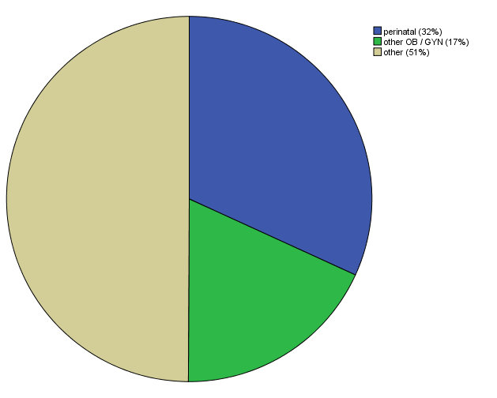
OB vs GYN cases ( total n=684)

Slide 28
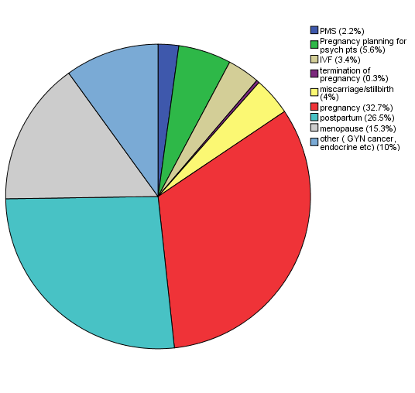
OB / GYN (n = 328) broken by category

Slide 29
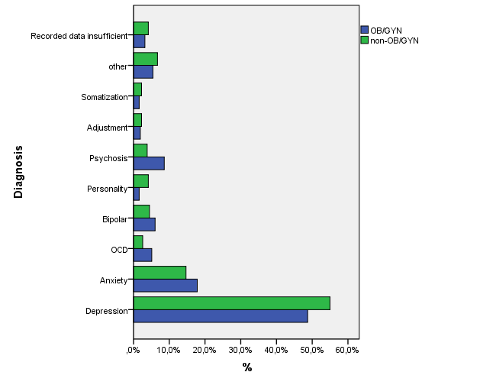
Diagnosis OB and GYN ( total n=684)
Notes:
29

Slide 30
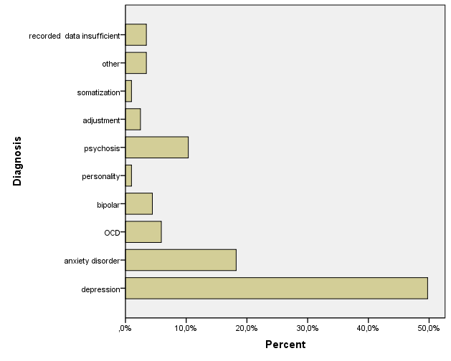
Diagnosis perinatal ( n=212)

Slide 31
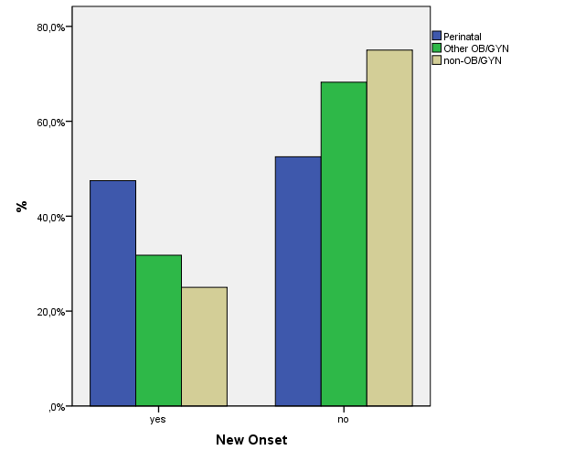
Previous Psychiatric History
Notes:
31

Slide 32
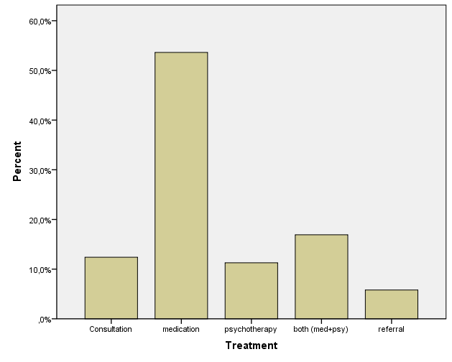
Type of treatment ( non-OB/GYN)

Slide 33
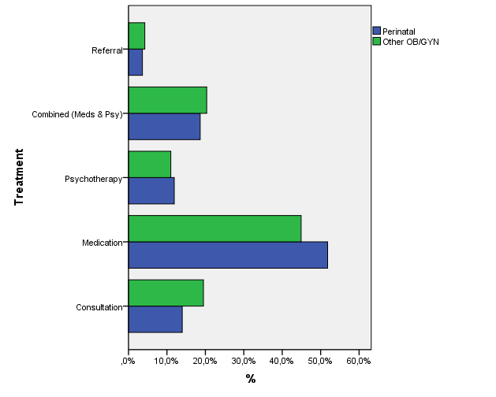
Type of treatment ( perinatal vs GYN)

Slide 35
What next?
Focused psychotherapy groups for special subpopulations (pregnant, new mothers, perimenopause, new father groups, etc)
Light therapy for depression in pregnancy
Mother –baby unit ( monitoring of mother-infant interaction and interventions to enhance bonding)
National Registry for women receiving psychiatric medication during pregnancy and lactation
Collaboration with other specialists form long-term follow-up of children of women with perinatal psychiatric disorders

